Slide 1
SDS-2025-0015 - Alternative NGSI-LD to oneM2M Interworking Approach
Martin Bauer,
09 February 2025

Slide 2
Overview
Interworking Approaches
  Synchronization (IPE-driven) approaches as described in ETSI GR CIM 022
  Request-driven interworking approaches
Next Steps

Slide 3
Interworking approaches
oneM2M Interworking in general
  Protocol adaptation
  Optional: data model adaptation
Interworking Approaches
  Synchronization (IPE-driven) approaches as described in ETSI GR CIM 022
  Request-driven interworking approaches
  Interworking can be unidirectional or bidirectional
Mapping
  General mapping approach (requires mapping language)
  Specific (resource or data model) mapping
  Different options where to put mapping information (oneM2M: label, semantic descriptor, IPE)
Non oneM2M
Non oneM2M
interface
interface
AE:
Interworking
Proxy
Proxy
Mca
Mca

Slide 4
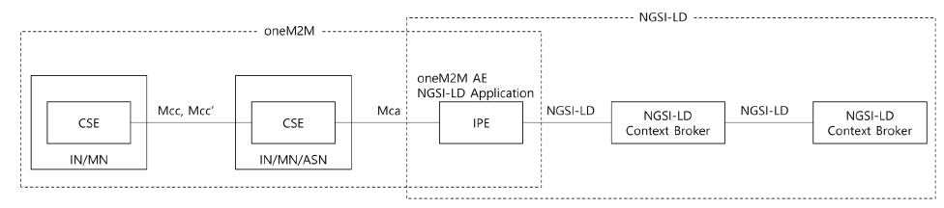
CIM 022: Synchronization (IPE-driven) approaches
IPE synchronizes information, duplicating it on both sides, requests can be efficiently answered
Depending on the use case, oneM2M data needs synchronizing to NGSI-LD context broker or NGSI-LD data needs synchronizing to oneM2M.
  oneM2M to NGSI-LD: This can be used when services are already implemented and data are already being stored in the oneM2M platform. The goal is for users to get data of oneM2M services using the NGSI-LD API.
  NGSI-LD to oneM2M: This can be used when device management or actuation is required from NGSI-LD enabled system (e.g. city operation centre) as well as when oneM2M applications make use of NGSI-LD data.
Synchronization approaches duplicate data, but enable more efficient information access

Slide 5
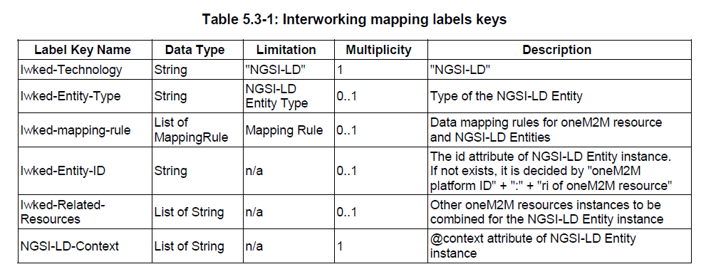
CIM-022: Label-based, dynamic interworking scheme (1)
Uni-directional approach: IPE discovers relevant information based on labels, retrieves information, and creates/updates information in NGSI-LD Broker accordingly.

Slide 6
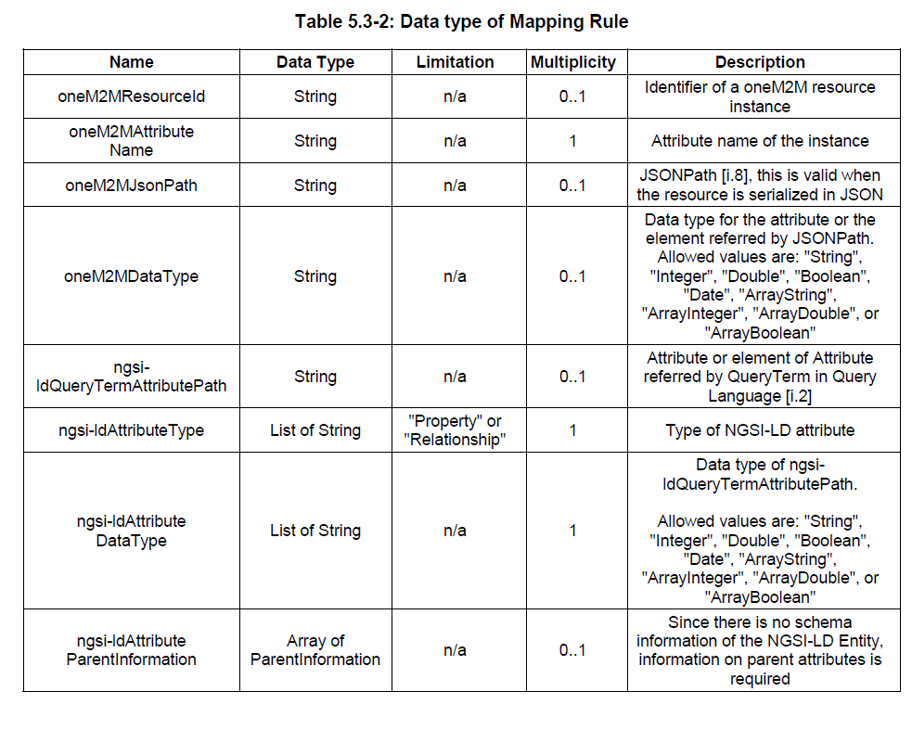
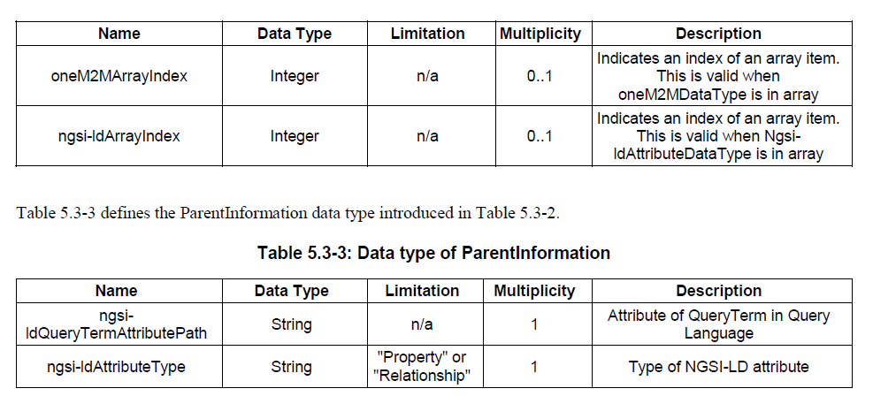
CIM-022: Label-based, dynamic interworking scheme (2)

Slide 7
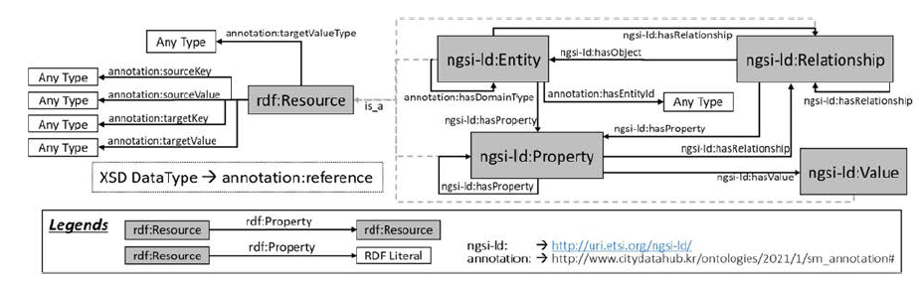
CIM-022: Ontology-based, dynamic interworking scheme
Uni-directional approach: IPE discovers relevant information based on semantic queries to semantic descriptors, retrieves information, and creates/updates/deletes information in NGSI-LD Broker accordingly.

Slide 8
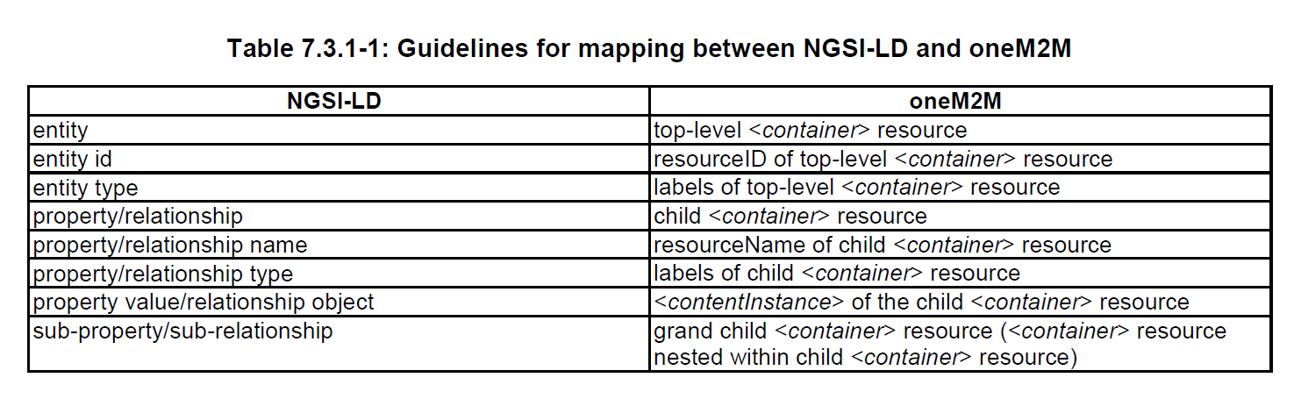
CIM-022: Static bi-directional “resources to entity“ mapping (Fed4IoT approach)
Bi-directional approach: entities and are mapped to oneM2M resource structures and labels in bi-directional way. Using subscriptions, the IPE ensures synchronization in both directions.

Slide 9
Generic mapping of NGSI-LD data to oneM2M Resources (Fed4IoT project)
Granularity of resources needs to be decided
  Resource per NGSI-LD attribute (property or relationship) [as in CIM-022]
  Resource per NGSI-LD entity
  Resource per group of NGSI-LD entities
Depends on typical requests
  Requests pertaining to (parts of) entities have to deal with high overhead the larger the entity information that needs to handled
  Requests pertaining to many entities are expensive, if there is a fine-grained distribution across resources, as there need to be many requests to retrieve/update resources

Slide 10
Request-driven approach
Interworking acts on a request basis, e.g.
NGSI-LD request triggers activity of IPE, requesting
information from oneM2M system
Pro: no duplication of information needed,
only active, if there is a request
Con: putting result together may be slow,
requiring many requests
(too slow in practice?)
Non oneM2M
Non oneM2M
interface
interface
AE:
Interworking
Proxy
Proxy
Mca
Mca

Slide 11
Proposed Mapping Approach based on IPE
Mapping information
Entity: Room123
Type: Room
Property: indoorTemperature
Unit: Celsius
Extract value: <content>
Alternative to CIM-022, ontology-based approach:
Put mapping information into Interworking Proxy → instead of internal requests, Mca requests are necessary
Depending on NGSI-LD request, the number of required Mca requests can range from a few (e.g. retrieve single entity with few properties) to a very large number: (e.g. graph query with many entities)
Non oneM2M
Non oneM2M
interface
interface
AE:
Interworking
Mapping information
Entity: Room123
Type: Room
Property: occupancy
Extract value: “<occupancy>“##“
</occupancy>“
Proxy
Proxy
Mca
Mca
Mca requests + filtering,
instead of internal requests

Slide 12
High-level comparison of IPE vs. internal approaches
IPE approaches also possible – trade-off between synchronization-based and request-driven approaches
IPE approaches require (often large number of) requests using external binding, overhead of access control
Internal access is much more efficient
Internally, more optimizations possible / cheaper,
e.g. indexing, pre-fetching of information, pre-processing

Slide 13
Next Steps
Definition of mapping language
Ensure this can be efficiently implemented (e.g. index structures) & make sure oneM2M access control is enforced (similarity to case of semantic information in triple store as defined in TS-0034 Semantics Support)

