Slide 1
Collected Issues with Notification Target Removal
Andreas Kraft – Exacta GSS
1

Slide 2
Unsubscribe from a List of Notification Targets
Two Methods
Method 1: Return a response to a notification with the target removal indicator set to true
Method 2: Send a DELETE request to the <notificationTargetSelfReference> virtual resource of a <subscription>
Removal then happens according to the rules defined by the notification target policies.
Those rules are defined by the AE or the CSE (as a default policy).

Slide 3
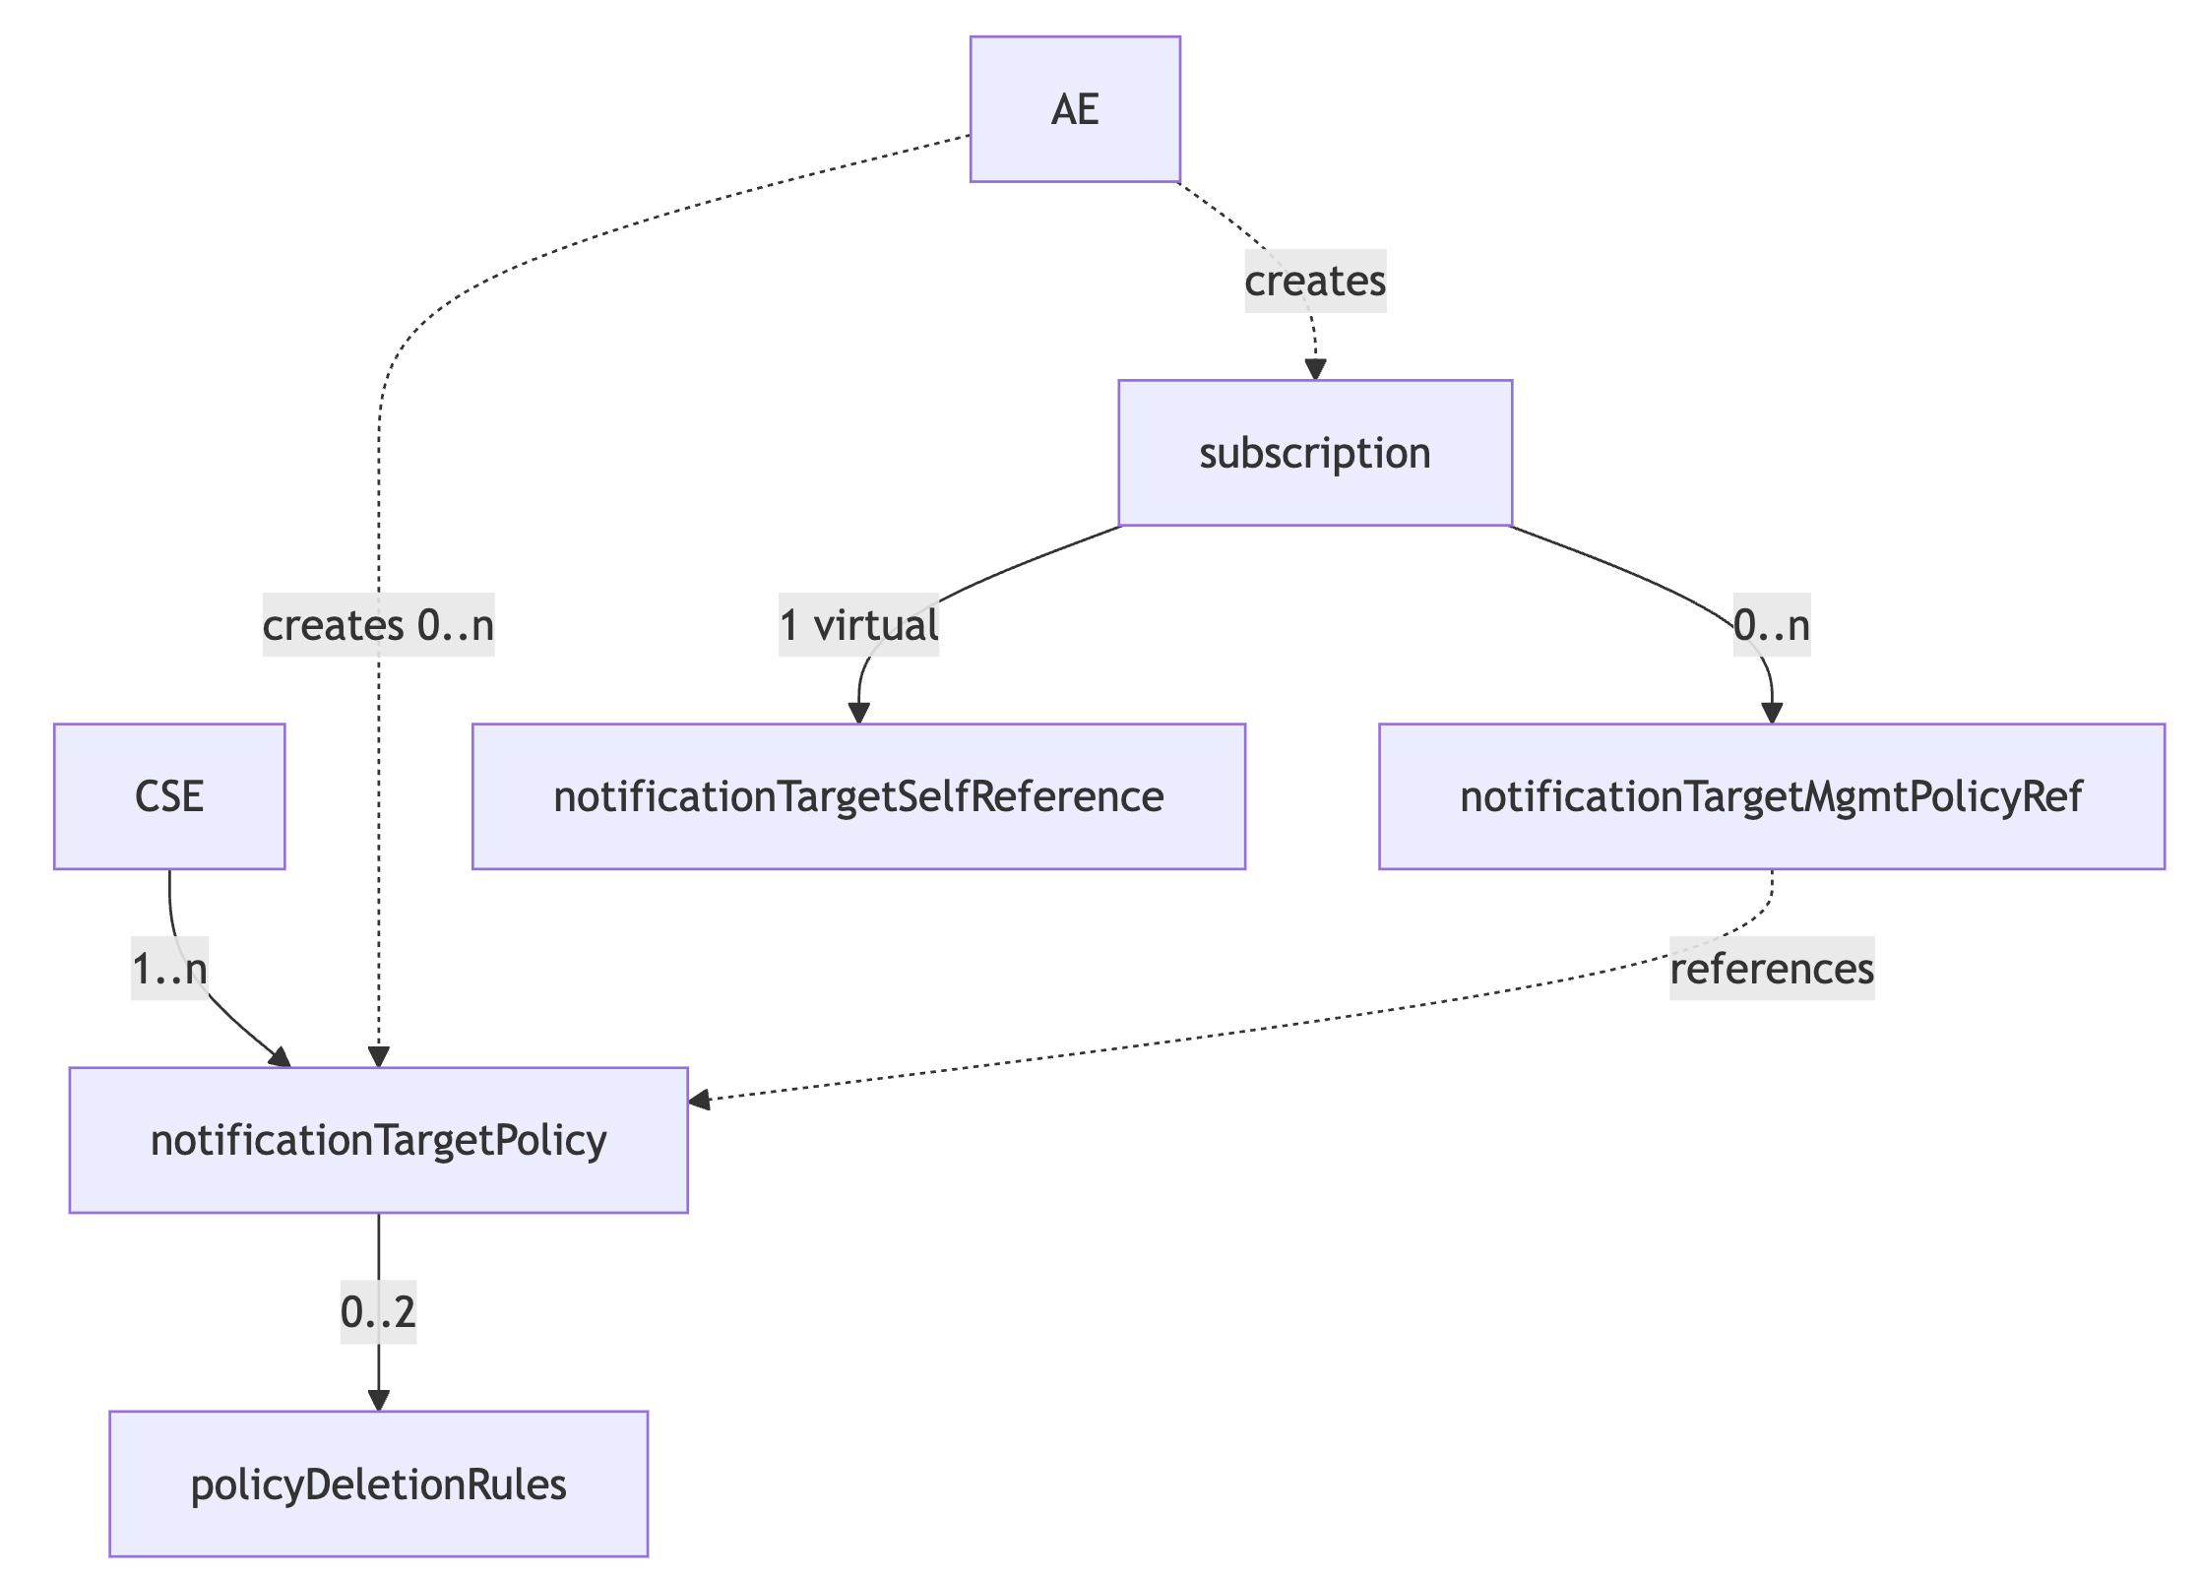
Resource Structure
Every <subscription> and <crossResourceSubscription> has a <notificationTargetSelfReference> virtual resource
Every CSE must have 1 <NotificationTargetPolicy> resource that acts as a "Default" policy fallback
AEs must be allowed to create <NotificationTargetPolicy> resources as direct <CSEBase> child-resources

Slide 4
Issues with Target Removal Indicator in the Response (1)
TS-0001
  Defined in Table 10.2.10.7-1
  If the response includes 'targetRemoval' indicator which is set to TRUE, then the Notifier(i.e. the Originator of the Notify request) shall perform the procedure in clause 10.2.10.8 (Notification target removal handling procedure).
  And in clause 10.2.10.6 Notification procedures, and clause 10.2.10.8 Notification Target removal procedure
TS-0004
  Not mentioned at all.
  Should be in Table 6.4.2-1 “Data Types for Response primitive parameters”, e.g. Target Removal Indicator | xs:boolean | 0..1 | ...
  Shortname is missing
  Behavior should be defined in notification response processing
TS-0008
  Mapping should be in Table 6.2.2.4.0-1: Definition of oneM2M Options
TS-0009
  New mapping clause under clause 6.4 Header Fields is needed

Slide 5
Issues with Target Removal Indicator in the Response (2)
Alternative: Remove this method completely
We already have a method to remove notification targets by sending a DELETE request to the <notificationTargetSelfReference> resource.
The chance for a notification target to remove itself is only when it received a notification.

Slide 6
<NotificationTargetSelfReference> (1)
Issues TS-0001
Clause 10.2.10.9: Spelling of resource name in first paragraph
Clause 10.2.10.8 spelling of parameter "targetRemovalAllowance" (as defined in TS-0004) is written as "removalAuthorization" (3.Step)
Clause 10.2.10.8 spelling of parameter 'targetRemovalRequest' (as defined in TS-0004) is written as 'targetRemoval' (4. Step).
  This is not the ’targetRemoval’ indicator that is set in a response.
Clause 10.2.10.8, step 3 is incorrect. This is the very first step, before sending a notification and getting a response.
  “If the action is "seek authorization from the subscription creator", then the Notifier shall return a successful response to the Notification Target if applicable [...]
  This would always send a "success" response to the request originator, independent from the answer of the notification target.

Slide 7
<NotificationTargetSelfReference> (2)
Issues TS-0004
What is the Response Status Code when successfully executing the DELETE procedure? It may not be DELETED because the resource is not deleted.
  Proposal: OK
What is the behaviour when a <notificationTargetPolicy> could be found (when searching the request originator in the notificationTargetURI attributes), but the notificationPolicyID is either not present (ie. It is optional), or the resource could not be found or the referenced resource is not a <ntp> resource.
  Proposal: use the "Default" \<ntp> resource.
What is the behaviour when there is no "Default" <NTP> resource?
What is the behaviour when there is NO PDR> child resource?
  Proposal: If there are no <policyDeletionRules> resources, then the Hosting CSE shall perform the action as specified in the action attribute of the <NTP> resource
The last originator might be removed from a <subscriptios>’s notificationURI attribute (which is 1L). This will leave an empty list. Is this okay?

Slide 8
<NotificationTargetSelfReference> (3)
Issues TS-0004 cntd
When sending notifications to the creator (inform or inquire), do those notifications count towards sent notifications in the *notificationStatsInfo* attribute?
Proposal: No
When sending notifications to the creator, who is the originator of the notification? The CSE, or the request originator? The request originator could be helpful, but unusual.
  Proposal: ???
In the DELETE procedure, the construction of the notifications (step c and d) needs to be more exact (e.g. parameters to set). Another issue: How to set the originator ID in the notification?
In the DELETE procedure, step c): The procedure defined here requires the setting of “Notification Target removal allowance indication” in a response. What is this? There is no attribute for this defined.
  Proposal: Treat a Response Status Code of "OK" as allowance indication. Any other RSC is disallow indication.

Slide 9
<notificationTargetMgmtPolicyRef> (1)
TS-0001
Spelling of attributes "notificationlPolicyID" is wrong (extra "I")
Description of "notificationTargetURI" is a bit confusing:
  address(es) of the resource subscriber receiving a notification. The notificationTarget URI shall be listed in the notificationURI attribute of the parent <subscription> resource, otherwise the default Notification Target policy shall apply.
  Proposal:
  URI(S) of the resource subscriber receiving a notification. If a URI is present in the in the notificationURI attribute of the parent <subscription> resource, then the <notificationTargetPolicy> resource referenced in the notificationPolicyID attribute shall apply, otherwise the default Notification Target policy shall apply.
Are duplicate URIs allowed?

Slide 10
<notificationTargetMgmtPolicyRef> (2)
TS-0001 cntd
Clause 10.2.10.8 Notification Target removal procedure . The text is
  Otherwise, the Notifier shall check if there is a <notificationTargetMgmtPolicyRef> resource which has the creator attribute set in the corresponding <subscription> resource and there is a <notificationTargetPolicy> resource which has the policyLabel attribute set as "default" and the creator attribute is equal to the creator of the <subscription> resource.
  This last part could be misleading. It should be "... to the original creator..." , otherwise someone may use the creator attribute. However, the text in TS-0004 “7.4.33.2.4 Delete” is:
  The Hosting CSE shall find a <notificationTargetPolicy> resource which has the policyLabel attribute set as "Default" and the creator attribute set as the Originator ID.
  Proposal: Change the bold text to "the creator attribute set to the original creator of the parent <subscription>".

Slide 11
<notificationTargetMgmtPolicyRef> (3)
TS-0004
Clause 7.4.30.2.3 Update: Here should be a similar procedure as with CREATE
The validity of the notificationTargetURI attribute should NOT be tested (ie. are all the values be present in the parent's nu attribute), because the parent can be updated with different values later, and the attributes can become out of sync anyway.
Could the notificationPolicyID be non-CSE-relative?
What happens, if the notificationPolicyID points to a non-existing resource?
  Proposal: Fallback to system ”Default” <notificationTargetPolicy> resource

Slide 12
<notificationTargetPolicy> (1)
TS-0001
Table 9.6.3-1: Child resources of \<CSEBase> resource:
  <notificationTargetPolicy> should be “1..n” instead of “0..n”, because there must always be the "default" one. Or ”1” if we decide to move AE-specific ones under the <AE> resource.
Clause 9.6.32: Decide whether we use "default" or "Default" as the default indicator. See also TS-0001 Table 9.6.32-2, TS-0001 clause 10.2.10.8, TS-0004 7.4.33.2.4
  Proposal: Use "Default"
Table 9.6.32-2: Attributes of <notificationTargetPolicy> resource, attribute rulesRelationship
  Spelling error in description
  This attribute should be mandatory with a meaningful default. It is mandatory if more then one child resource <policyDeletionRule> is present, but this can only be checked after the resource and its child resources has been checked. The default must be defined otherwise this becomes an interoperability problem.
  Proposal: cardinality 1 and in TS-0004 a meaningful default (AND)
  Remark: The cardinality 0..2 is enforced in the <PDR> CREATE procedure
Could there multiple NTP resources with the "Default" or same label and the same creator / none-creator? Basically, for any creator there should only be one plbl value, and the same when the creator is not present.
  If yes, then this needs to be reflected in the CREATE and DELETE procedures.

Slide 13
<notificationTargetPolicy> (2)
TS-0004
Table 7.4.31.1-3: "action" cannot be O/NP and no default because the cardinality of the attribute is 1
  Proposal: make it M/NP
Table 7.4.31.1-3: Attribute rulesRelationShip : See discussion for TS-0001.
  Proposal: Assign a default "AND" if not present. "AND" because the logical operator default for the <policyDeletionRules> is "OR"
  Similar for attribute policyLabel. Change O/O -> M/O . There is no default for a mandatory attribute.
CREATE and UPDATE procedures miss procedures when the rulesRelationship attribute is missing.
  Proposal: Add default
CREATE and UPDATE: plbl attribute must not be an empty string, and it must be unique for the same creator or empty creator.
CREATE: Missing procedure if "Default" in plbl attribute is double present
  Proposal: BAD REQUEST
DELETE procedure: System "Default" <NTP> resource must not be deleted
General question: Should xs:token be actually xs:nmtoken? (e.g. in plbl attribute)

Slide 14
<notificationTargetPolicy> (3)
Miscellaneous Discussion
What happens to the <notificationTargetPolicy> resources when the creating <AE> is unregistered?
  Under some circumstances it may be that it cannot be removed from the CSE again (except expiration)
  Should it be deleted when the registering <AE> is unregistered?
  Or assigned a custodian?
  Proposal
    Only allow the CSE’s default under the <CSEBase>.
    <NTP> resources created by AEs must be created under the respective <AE> resources.

Slide 15
<policyDeletionRules> (1)
TS-0001
In table Table 9.6.33-2 the description of deletionRules not very precise.
  Lists the applicable rules. The rules include at minimum; time of the day, geographical location of the Target Notification. Where the rule applies.
Attribute deletionRules should be 0..1 (not list). The lists are part of the "m2m:deletionContexts" complex attribute
The default for the deletionRulesRelation attribute should be mentioned in the attribute description. It is defined as "OR" in TS-0004
In clause 10.2.10.8 Notification Target removal procedure, the procedure specifies what steps are performed when the evaluation of the <policyDeletionRules> yields true, but not what the behavior is when the evaluation yields false.
  Proposal: if the evaluation results in false, then removal request is rejected, and the CSE shall return the response status code ORIGINATOR_HAS_NO_PRIVILEGE.

Slide 16
<policyDeletionRules> (2)
TS-0004
The attribute deletionRules may not be present. Or the lists could be empty. What is the behavior when they are not present?
  Proposal: This <PDR> resource evaluates to True.
See above remark, procedure for negative evaluation in TS-0001, clause 10.2.10.8. Behavior when the policy evaluation yields false. This should be added to the DELETE procedures of the <NotificationTargetSelfReference> resource.
The geo-location policy should be better specified. Currently there is no explanation how to run a query against them. For example, what is the relevant location, the one from the CSE or the one from the device? How to retrieve the location? Could we perhaps add the IP address policy from ACP as well?

Slide 17
Thank you

