Slide 1
GCF oneM2M Certification Program Updates
Keebum Kim, TTA, keebum.kim@tta.or.kr
TDE #40

Slide 2
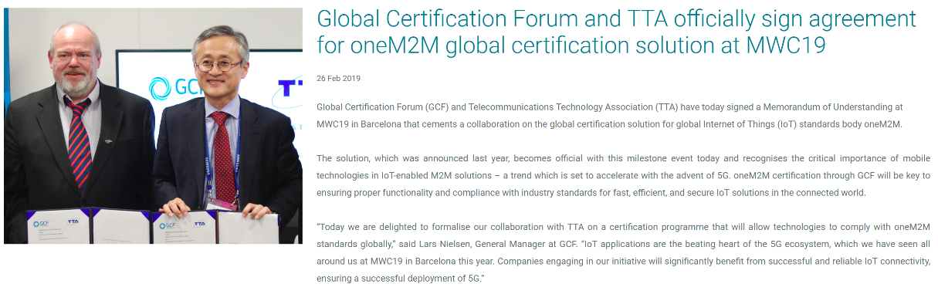
GCF-TTA MoU
First MoU document with brief contents was concluded on 2019.02.26 at MWC 19.
Second, MoU Annex2 document including detailed descriptions was concluded on 2019.04.26

Slide 3
Current Status of GCF oneM2M Certification Program
First Draft for oneM2M WI (IAG#6, 01/2018)
  oneM2M Interoperability Testing (WI-291)
  oneM2M Conformance Testing (WI-292)
GCF-oneM2M Joint Workshop (oneM2M TP#32, 05/2018)
  Exchanging information, Consultation on cooperation
Approval of WI-291, WI-292 (IAG#14, 10/2018)
  oneM2M Interoperability Testing (WI-291) Approved. (IAG#14)
  oneM2M Conformance Testing (WI-292) Approved. (IAG#16bis)
Completion of Test System validation (IAG#16, 01/2019)
  Complete of the oneM2M conformance test system

Slide 4
Policy in GCF oneM2M Certification Program
oneM2M Conformance Testing
  RTOs must have ISO17025 for conformance.
  RTOs must use validated test platform which is proven by GCF test platform validation process.
oneM2M Interoperability Testing
  Work Item Certification Entry Criteria (CEC) : At least one approved RTO is able to execute the test cases. (from WI-291)
  Requirements of ISO17025? Test equipment?

Slide 5
Issues for the successful operation of oneM2M Certification Program
According to the policy in GCF, any RTO could be a validation organization to progress oneM2M conformance test platform validation.
  Poor quality of the test platform could effect the quality of the conformance test.
Because of the lack of validated test equipment for interoperability test, to ensure the quality of the testing, RTO audit policy is necessary.
  Interoperability test equipment mostly be the ordinarily certified product.
  Unlike with the conformance test platform, performing the interoperability test could be difficult and could cause unexpected result.
Comparing to 3GPP technology, oneM2M certification program is newly born.
  Less experts to review the test results before the device declaration.

Slide 6
Proposal to ensure the quality of oneM2M Certification Program in GCF
To ensure the quality of oneM2M Certification Program,
  mandate ACE for certain period.
  Previously TTA as the certification body, reviewed the test report and the results in detail.
designate the previous certification body as the only validation organization for a period.
  Conformance test quality could be guaranteed by controlling the quality of the test platform.
apply audit system to ensure the interoperability testing.
  Previous certification body will be the Auditor Body for a period.

Slide 7
Further Actions
Preparing oneM2M WI CRs
  Targeting IAG#20 (5/23), IAG#21 (6/18)
  Including some minor changes for Rel-1
  Getting approval at SG#79 (6/25-27)
  Preparing oneM2M Rel-2 WIs.
Final official launch for oneM2M Certification Program
  After approval at SG#79, targeting 1st of July 2019.

Slide 8
Thanks,

