Slide 1
Discussion on
S-Stem-AD-ID registration
oneM2M TDE#40
KETI, SeungMyeong Jeong
Convida Wireless, Bob Flynn

Slide 2
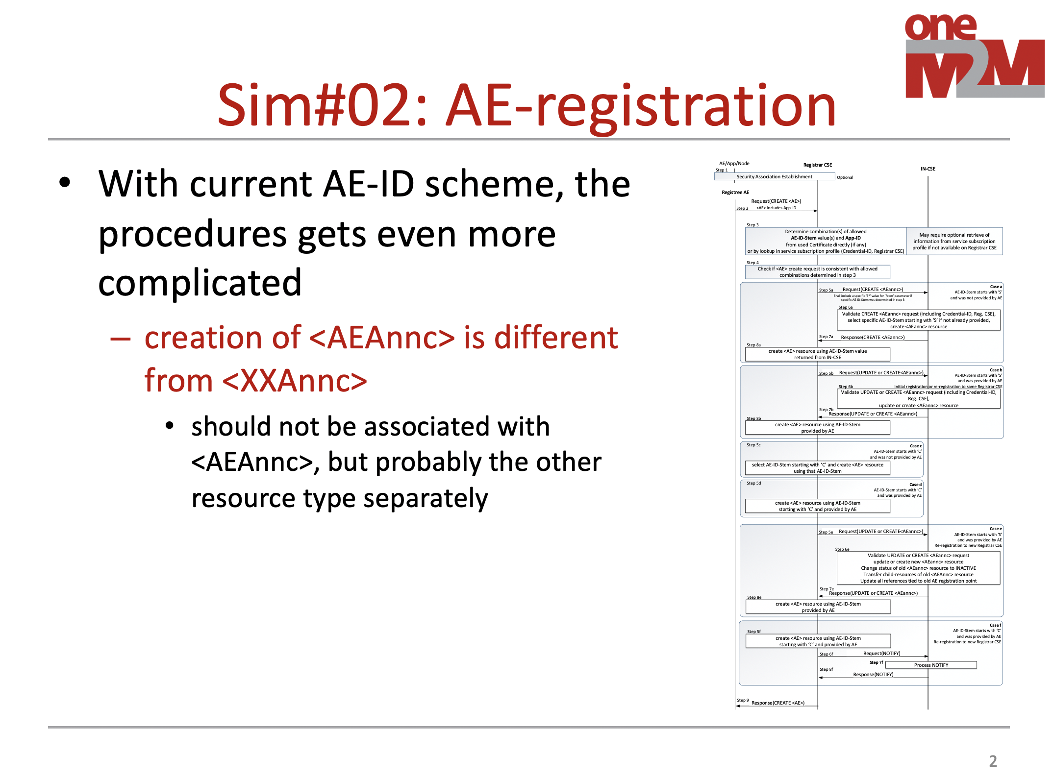
The same discussion before
At TP#36, with the ARC-2018-0221-Discussion_on_Rel-4_TS-0001_Simplification
  it was suggested NOT TO USE <AEAnnc> resource for S-Stem-AE-ID registration
  the motivations are
    it makes AE registration really complicated or strange
    AEAnnc resouce procedures became different from XXAnnc’s, which is UNNECESSARY

Slide 3
What’s the situation?
What do we mean by “AE registration became complicated”?
  <AE> resource creation gets failed when <AEAnnc> resource creation fails ➔ unnecessary dependency for resource announcement
  put S-Stem-AE-ID into resourceID of <AEAnnc> resource on IN-CSE first, and the same AE-ID is assigned to resourceID of <AEAnnc> resource ➔ the only rule that we define resourceID which is completely implementation specific other than this case
Step 007a: When the validation and verification in Step 006a completed successfully, the IN-CSE shall create <AEAnnc> resource with an Unstructured-CSE-relative-Resource-ID equal to the value of the AE-ID-Stem, replace the AE-ID-Stem for the trailing ‘S’ character in the Unstructured-CSE-relative-Resource-ID present in the link attribute if the AE-ID-Stem was selected by the IN-CSE, and send a successful response to the Registrar CSE.
Step 008a: Upon reception of a successful response from the IN-CSE, the Registrar CSE shall use the Unstructured-CSE-relative-Resource-ID that was used for the <AEAnnc> resource on the IN-CSE also as the assigned Unstructured-CSE-relative-Resource-ID for the <AE> resource to be created on the Registrar CSE and continue with action (4) of Step 002 of the non-registration related CREATE procedure in clause 10.1.2.

Slide 4
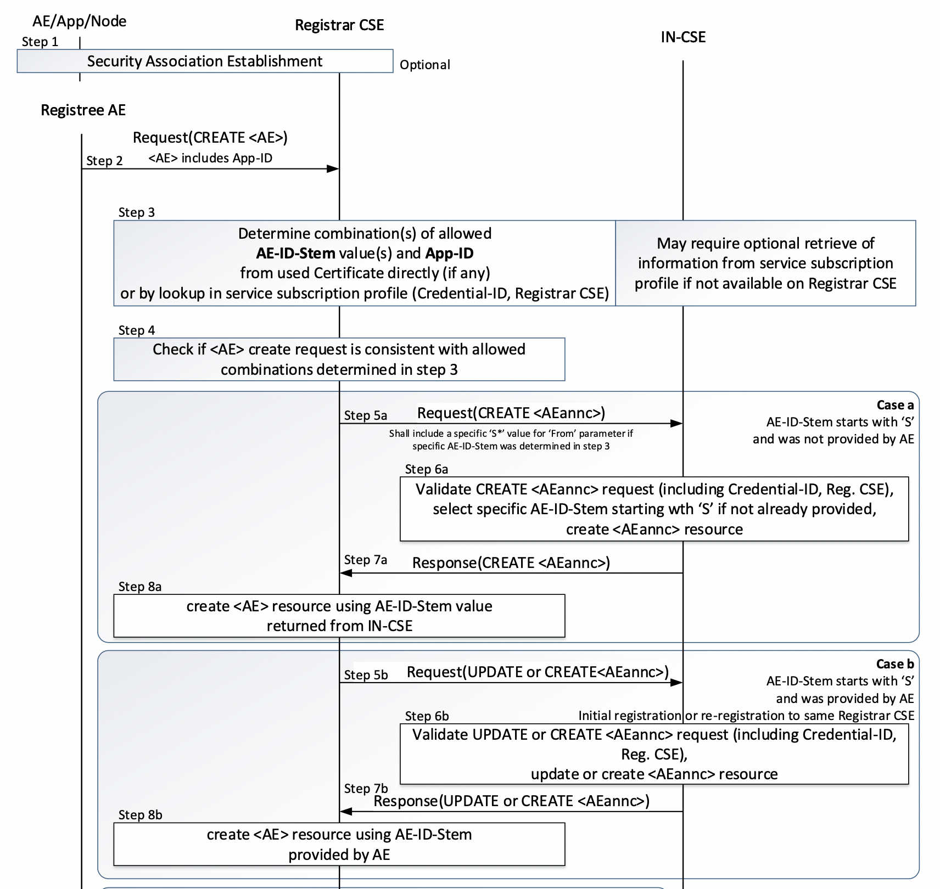
What’s needed for S-Stem registration?
We need the uniqueness of S-Stem-AE-ID in the M2M SP domain
  with the other dedicated resource type other than AEAnnc
  for example, SStemAEID resource type only allowed for IN-CSE
    the sstemid of the successfully created <SStemAEID> resource can be used by the Registrar CSE
Let’s make it simple!
creation of <SStermAEID> resource with the sstemid attribute

Slide 5
Way forward
For rel-2 conformance testing
  let’s take this <AEAnnc> resource involving S-Stem-AE-ID registration from the mandatory feature for the product profiles, for now
  instead we can bring the SIMPLE solution (as illustrated like in the previous slide) and can put that later
Then apply this also to the IOP and test it

