Slide 1
Enhancement activities to oneM2M open sources
TDE-2023-0049-oneM2M_Open_source_software_course
Group Name: TDE#62
Source: Jieun Lee, Yoonmee Park, JaeSeung Song (Sejong University)
Meeting Date: 2023-12-04

Slide 2
Background
Overview on Open Source Software Design and Implementation
Enhancement activities
  Adopting new database
  Drag-and-Drop resource modelling
  Add bindings
  Interworking proxies
  Dashboard

Slide 3
Introduction to Open Source SW Class
Open source software design and implementation class
  University: Sejong University
  Objective: Introduce open source software projects and encourage students to contribute to open source communities (targeting oneM2M open source projects)
  Duration: 01. Sep. 2023 ~ 15. Dec. 2023 (Open every year in autumn term)
  Credits: 3 credits (3 hours in a week for 15 weeks)
  Number of students: 30~40 students (5~8 teams)
Curriculum
  Introduction to IoT technologies (definition, history, network technologies, cloud platforms, etc.)
  oneM2M introduction (architecture, bindings, APIs, main features, etc.)
  Tutorials from open source communities: ACME (Andreas Kraft, Deutsche Telekom), OM2M (Sherzod, Synchtechno), Mobius (Hyeonseo Son, SJU), tinyIoT (Jieun Lee, SJU) → Installation, configuration, basic running commands, code analysis and review for platform and application
  Git tutorials (history, overview, basic commands, etc.)
  Final pitch for the team projects

Slide 4

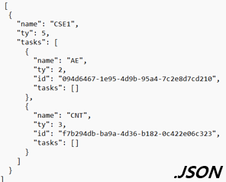

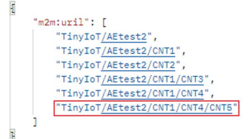

Drag&Drop Resource Modelling Tool
oneM2M Resource Modelling Tool
oneM2M Platforms
Main page
Local storage
Create request
Save in .json format
Drag & Drop Resources
Save
Modelling oneM2M resources
HTTP or MQTT
Main Page (User Interaction)
Hierarchical resource tree
Retrieve CSE Attributes
Load
Resource validation
Applicable to various platforms
(ACME, Mobius, tinyIoT, etc.)
Resource & Attribute Validation check
Creation Request by Hierarchical Addressing

Slide 5
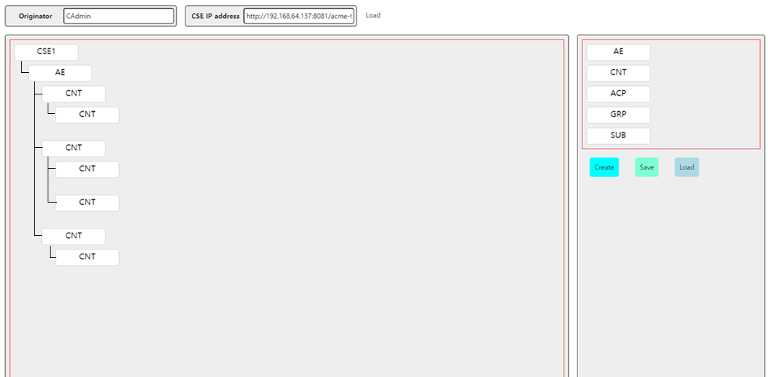
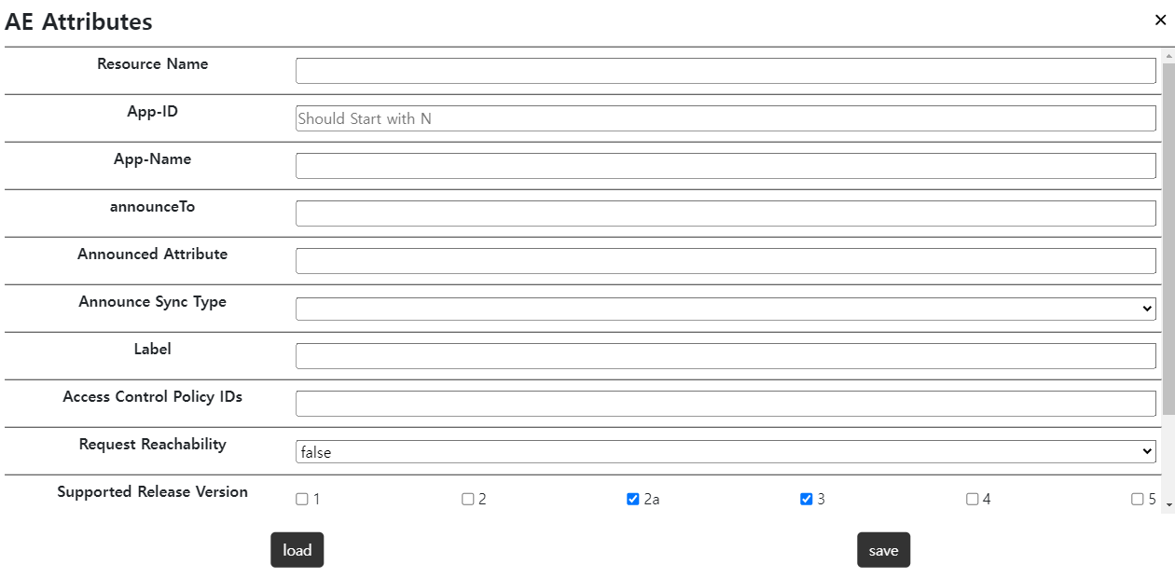
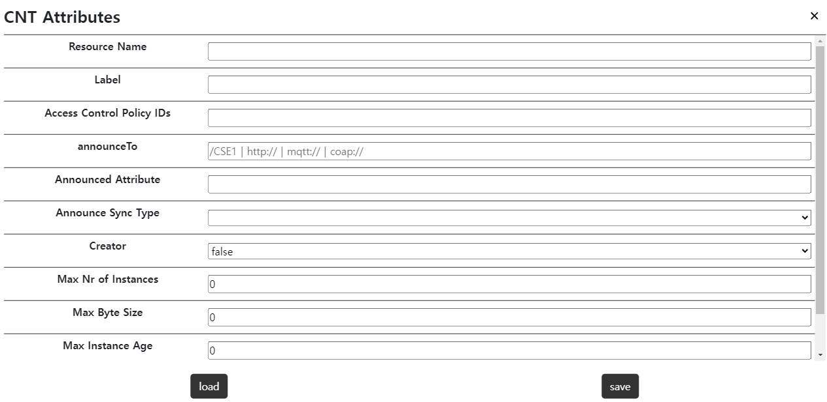
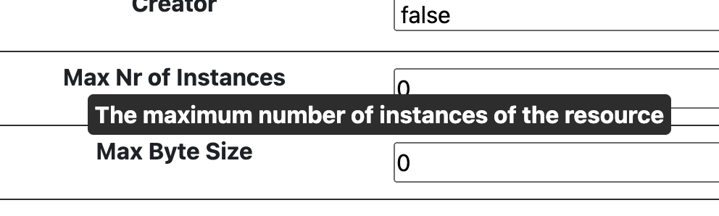
Drag&Drop Resource Modelling Tool
Draggable Resource
Retrieve and Set CSE Attribute Automatically
click
Main Modelling Page
Resource Attribute setting + Simple Explanation
Create :
Resource create requests to oneM2M server
Save :
Create date tree .json file in local storage
Load :
Load .json file from local storage and make resource tree

Slide 6
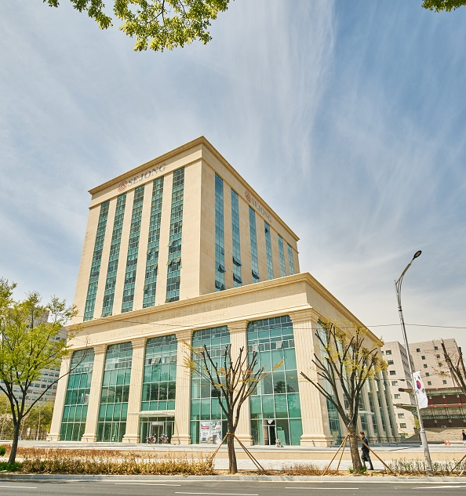
Digital Twin Application
Development of a smart elevator system for energy saving
Collect user data
  Who pressed button?
  Which level a button pressed?
  Which level the passenger moved?
Final expected dataset
  Statistic of passengers
  Actual elevator movement with time stamp
  Energy usage (based on ISO standardized algorithm)
AI center bld at Sejong Univ.
8 elevators

Slide 7
Thank you!

