Slide 1
oneM2M data model design tool
SesLab2023

Slide 2
Index
Overview
Goal
Tool Design

Slide 3
Overview
Using the oneM2M server platform, there were many difficulties in creating and using hierarchical resource structures.
Because of difficulty of searching Technical Specification many times.
So we decided to create a data modeling tool that is easy for oneM2M beginners to use and learn oneM2M.

Slide 4
Goal
Design tools that can be designed with drag and drop
Set the attributes of a resource
Validates the input of user
See the explanations for the resources and attributes

Slide 5
Tool Design

Slide 6
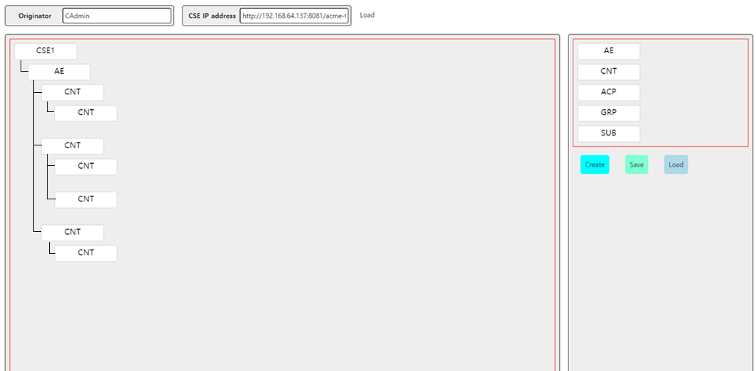
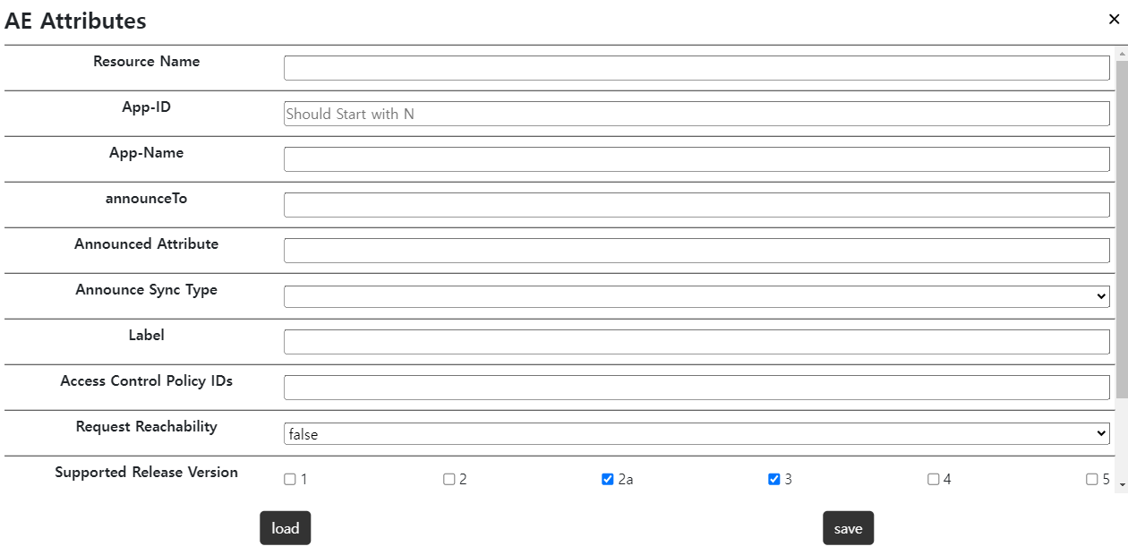
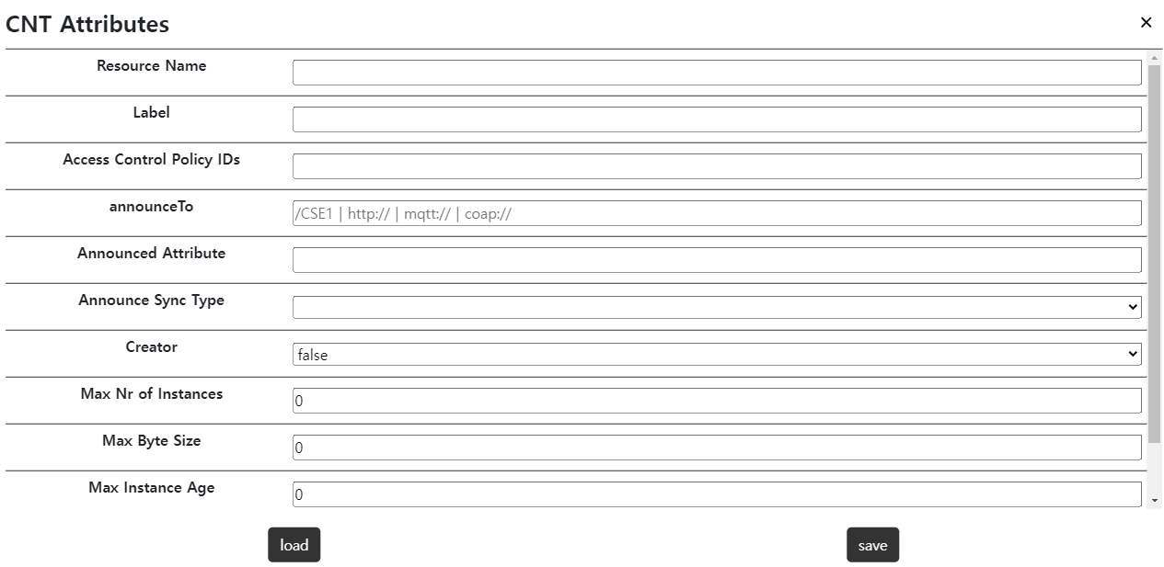
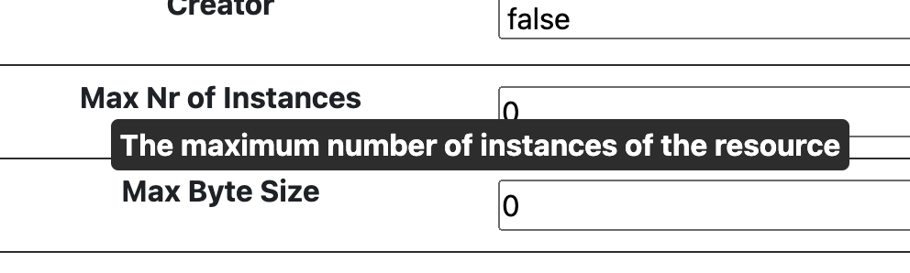
Main Page
Draggable Resource
click
Create :
Resource create requests to oneM2M server
Save :
Create date tree .json file in local storage
Load :
Load .json file from local storage and make resource tree
Resource Attribute setting + Simple Explanation

Slide 7

Main Page
Draggable Resource
click
Create :
Resource create requests to oneM2M server
Save :
Create date tree .json file in local storage
Load :
Load .json file from local storage and make resource tree
Resource Attribute setting + Simple Explanation

Slide 8
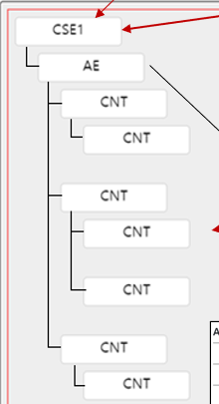
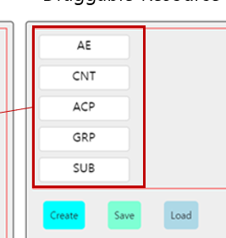
Main Page
Draggable Resource
click
Draggable
Create :
Resource create requests to oneM2M server
Save :
Create date tree .json file in local storage
Load :
Load .json file from local storage and make resource tree
Resource Attribute setting + Simple Explanation

Slide 9
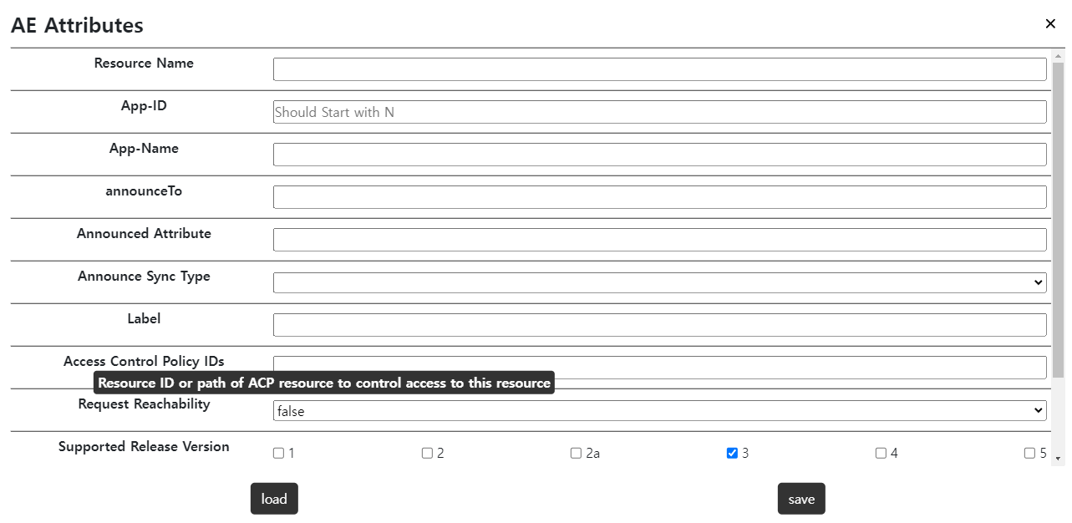

Main Page
Draggable Resource
click
Create :
Resource create requests to oneM2M server
Save :
Create date tree .json file in local storage
Load :
Load .json file from local storage and make resource tree
Resource Attribute setting + Simple Explanation

Slide 10
Resource & Attribute
support the following content. (All Mandatory, Some of Optional)
[accessControlContexts]
accessControlLocationRegion
accessControlIPAddresses
accessControlLimit
[AE]
[CNT]
labels
accessControlPolicyIDs
labels
accessControlPolicyIDs
announceTo
announcedAttribute
announceTo
announcedAttribute
announceSyncType
announceSyncType
creator
App-ID(M)
requestReachability(M)
maxNrOfInstances
maxByteSize
maxInstanceAge
supportedReleaseVersions(M)
pointOfAccess
[GRP]
[SUB]
labels
accessControlPolicyIDs
labels
accessControlPolicyIDs
creator
announceTo
announcedAttribute
notificationURI(M)
eventNotificationCriteria
announceSyncType
creator
groupName
subscriberURI
notificationEventCat
latestNotify
maxNrOfMembers(M)
memberIDs(M)
memberType
eventNotificationCriteria
notificationContentType
membersAccessControlPolicyIDs
consistencyStrategy

Slide 11



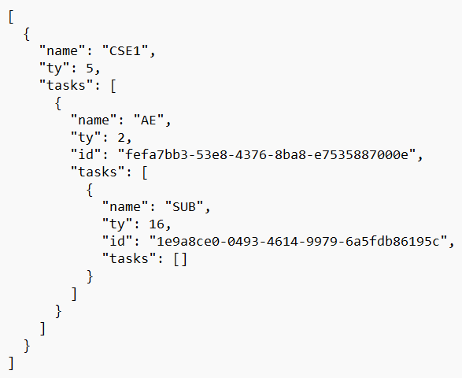
Architecture
Draggable resource design
Perform in variety oneM2M platform (TinyIoT, Mobius, ACME, …)
Support AE, CNT, GRP, ACP, SUB resources
Create requests in HTTP/MQTT
Save & Load in local storage (Validation Check)
CSE
AE
Create
Drag & Drop
SUB
HTTP or MQTT Communication
.JSON
Retrieve
Load
oneM2M Server
(TinyIoT, ACME, Mobius, etc.)
File Upload
(.JSON file)
Save
Hierarchical oneM2M Data Model

Slide 12

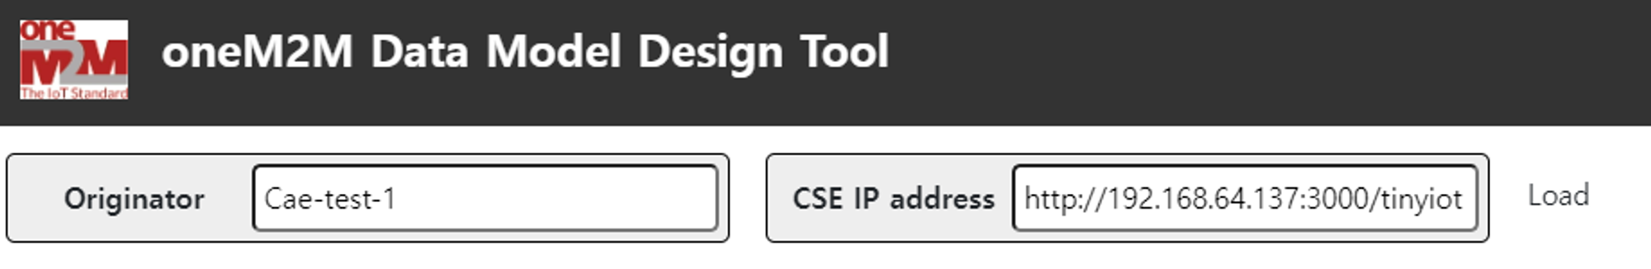
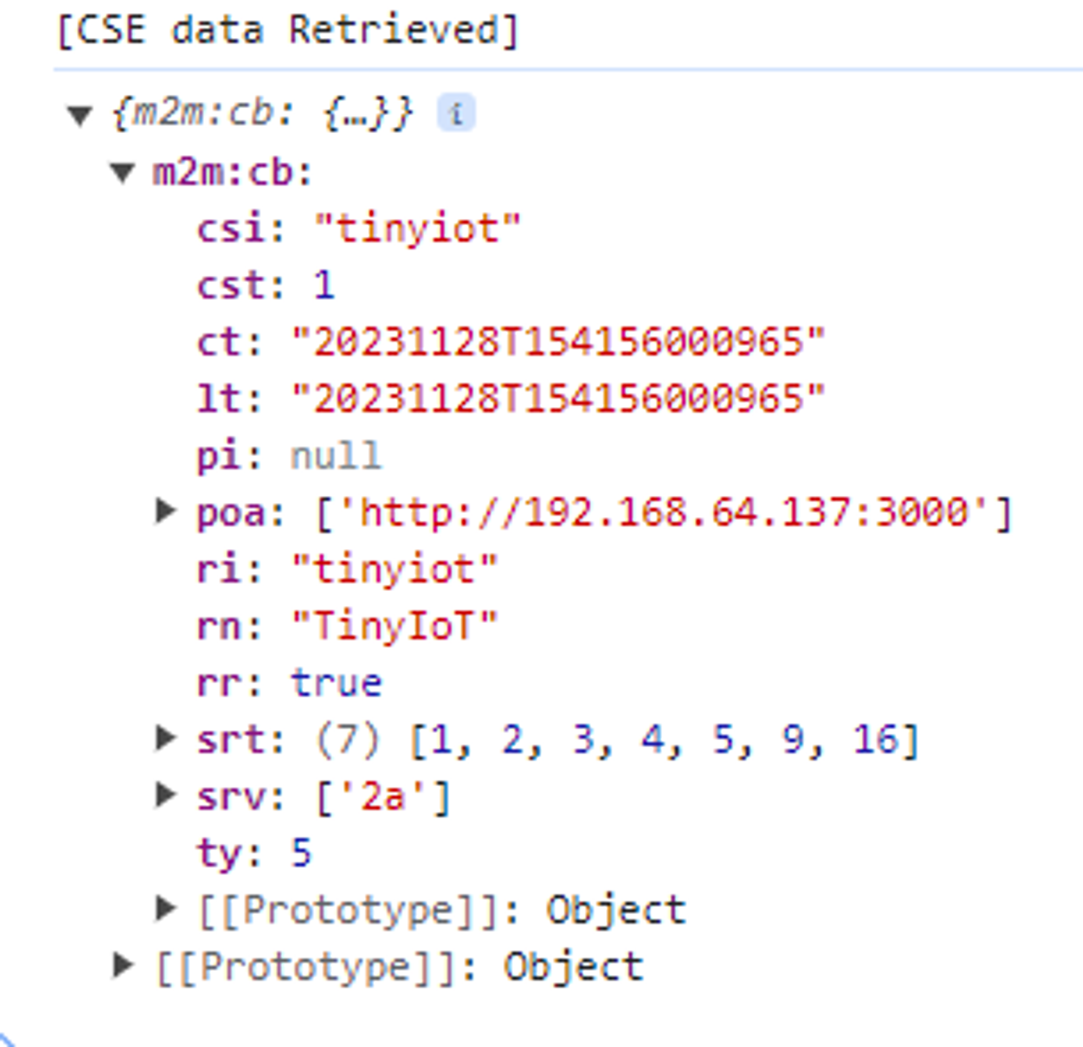
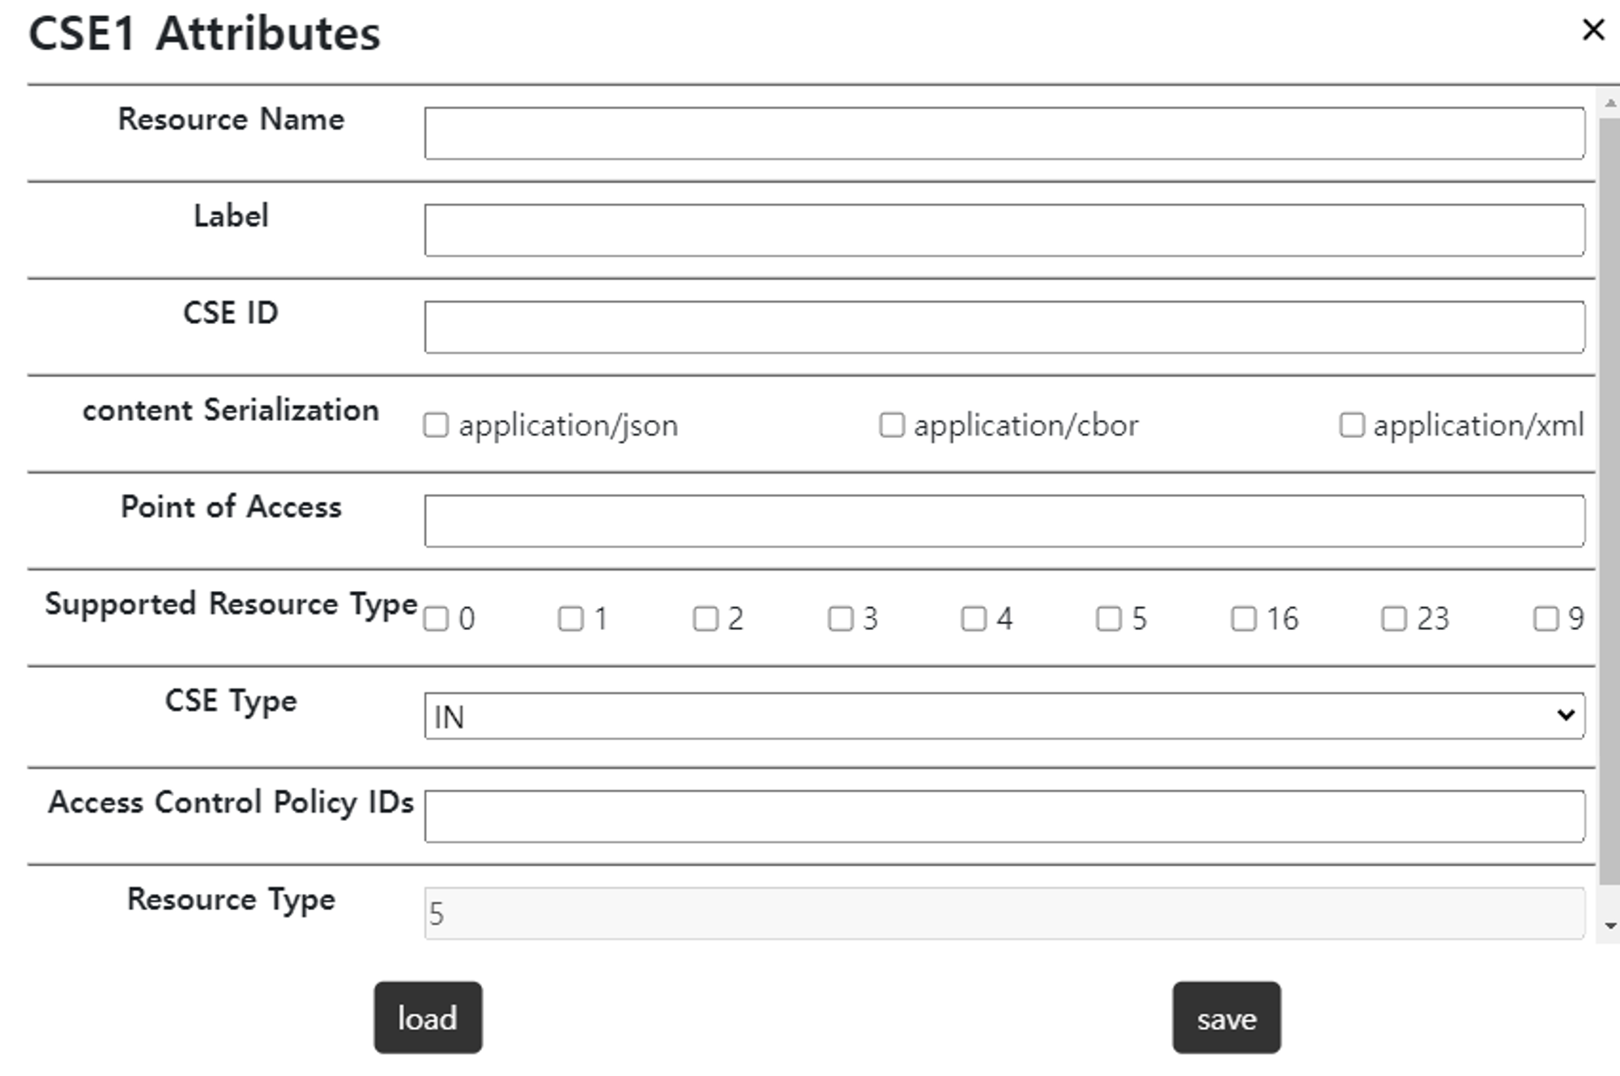
Retrieve CSE data
Set CSE attributes automatically
Retrieve
◀ CSE Information for Retrieve
Set Attributes
▲ Retrieved CSE Data
▲ CSE Attributes in Web

Slide 13

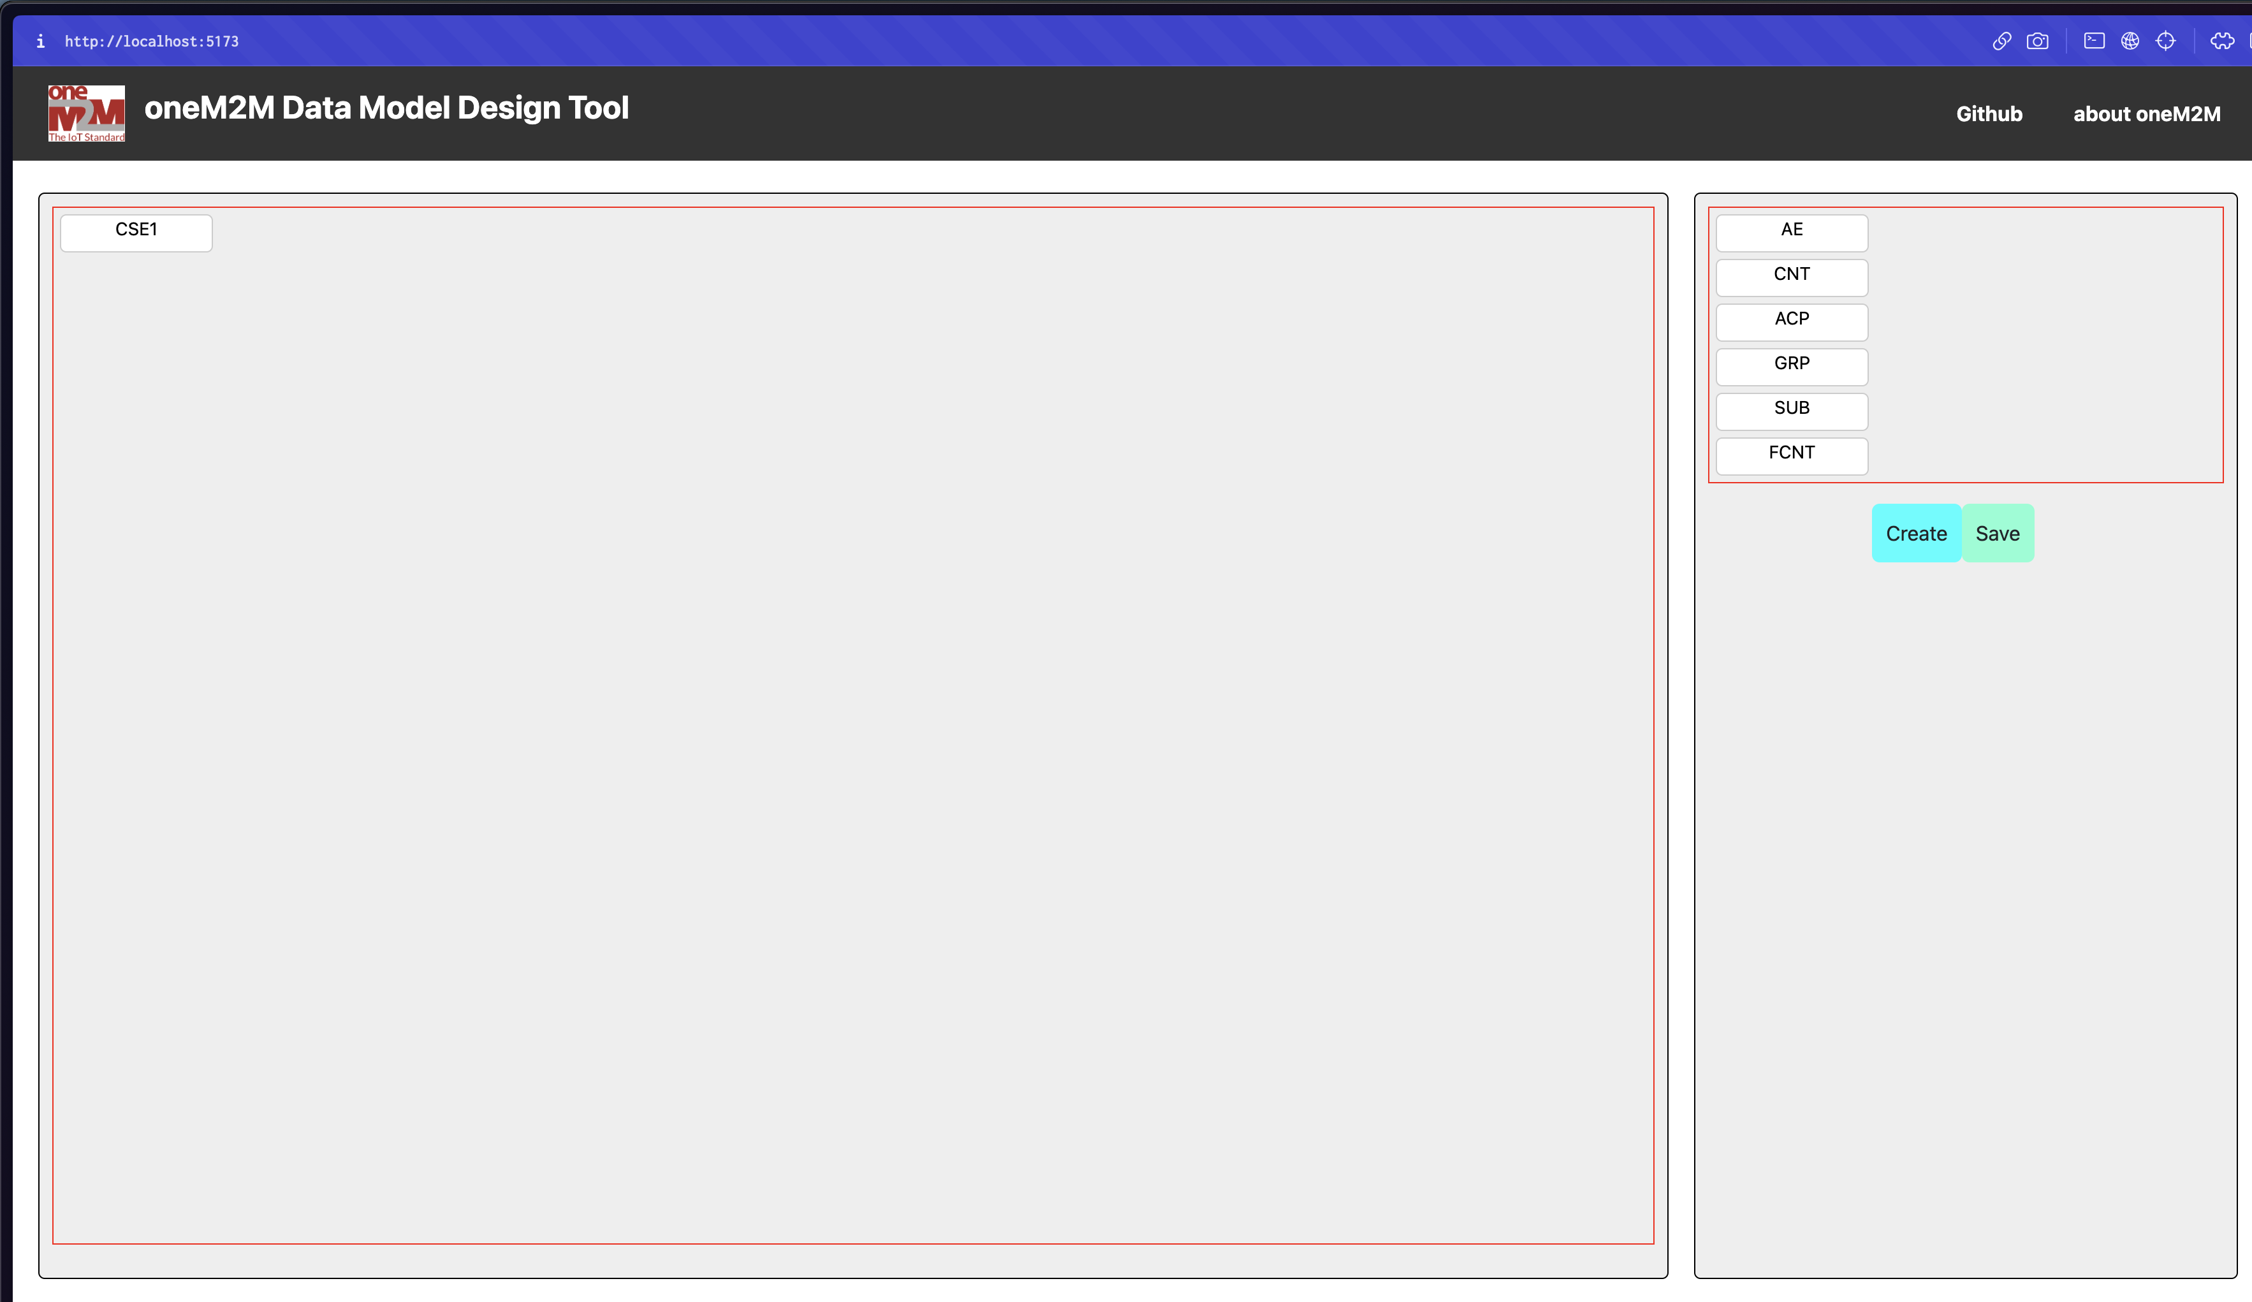

Function
User Page
Create
CSE
CSE
ACP
AE
SUB
Main Page
AE
HTTP or MQTT
.JSON
CNT
Save
Send or Retrieve
SUB
GRP
Local Area
JSON file
oneM2M Server
(TinyIoT, ACME, Mobius, etc.)
[Resource Type]
▲ Example

Slide 14
Future Works
Detail explanation for each resource and attributes
More validations for each attributes
Supports more resource types

