Slide 1
STF685 – Current Status in oneM2M
TDE-2025-0007
Prof. JaeSeung Song
Sejong University

Slide 2
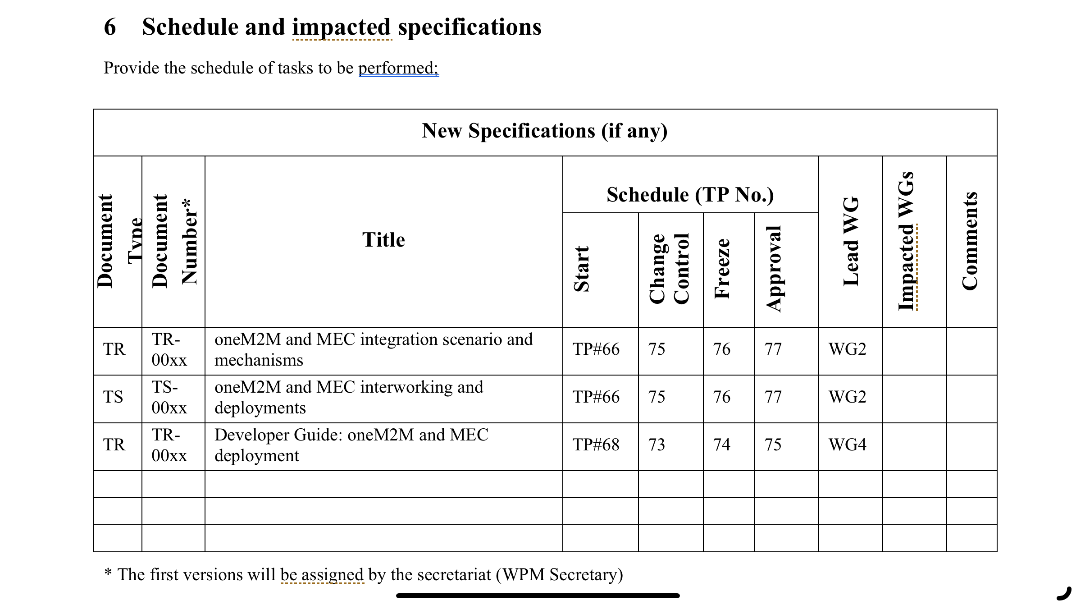
Schedule of STF685 related documents

Slide 3
Allocated document numbers
TR-0077: oneM2M and MEC integration scenario and mechanisms
TS-0042: oneM2M and MEC interworking and deployments
TR-0078: Developer Guide on interworking between oneM2M and MEC

Slide 4
Required actions
Develop TR-0077 and TS-0042 in parallel to identify use cases and requirements
  TR-0077: oneM2M and MEC integration scenario and mechanisms
  TS-0042: oneM2M and MEC interworking and deployments
Identify selected scenarios and solutions to support oneM2M and MEC interworking within the TR-0077 and TS-0042
Work on testing for the developed solutions
Work on the development of developer guide TR
  TR-0078: Developer Guide on interworking between oneM2M and MEC

