Slide 1
Collaboration with
Penn State University
Source: Bob Flynn bob.Flynn@exactagss.com
Meeting Date: 2025-11-11

Slide 2
oneM2M projects that feature
Nordic Semiconductor nrf 91xx
Fall 2021
  Cellular IoT Irrigation System for oneM2M + Nordic Thingy:91 (Nov 12, 2021) dev.hackster.io Penn State Sites
Spring 2022
  Cellular-based IoT using oneM2M Penn State Sites
Fall 2022
  OneM2M Thingy:91 Traffic Lights with Functional Tester (Nov 21, 2022). dev.hackster.io Penn State Sites
Spring 2023
  OneM2M-Based Cellular Over-the-Air Updates Penn State Sites
Fall 2023
  Cellular Based IoT Device Management following oneM2M Penn State Sites
Fall 2024
  Bike Share System with Cellular-Based IoT and oneM2M (Dec 7, 2024)
  includes Nordic nRF9161-DK using DECT NR+ dev.hackster.io Penn State Sites
Notes:
My entire career I have been involved with embedded development, cellular development and IoT research and development.
In 2019 I wanted to support college students learning the technologies relevant to IoT devices.
When I started Exacta Global Smart Solutions in 2020, I learned about the Pennsylvania State University Learning Factory.
Engineering students are required to complete a CAPSTONE project as part of the curriculum. So, I decided to sponsor projects.
I participate in standards development for oneM2M and I am the Chair of the Test and Developers Ecosystems (TDE) working group
Each project focuses on topics or features supported by oneM2M and each project focuses on cellular IoT devices.
Topics include basic concepts, custom data models, compliance testing, device management and OTA updates, and last year we looked at the new (at the time) DECT NR+

Slide 3

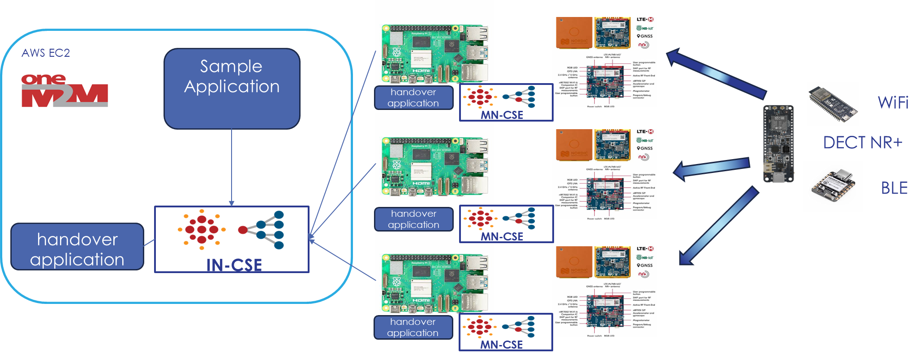
Penn State University CAPSTONE project
Fall 2025
Notes:
This year’s project, on going now, is exploring HANDOVER concepts. And it is doing this with the Nordic Semiconductor Thingy 91X.
The students are modelling a Multi-Access Gateway using the Thingy 91X, that supports WiFi, BLE and DECT NR+.
A oneM2M CSE is hosted on a rPI (or Jetson Orin Nano for more Edge computing use cases). The rPI monitors signal metrics and make decisions about the reliability of the connection.
The students learn about oneM2M and Nordic device development (Nordic Developer Academy:
nRF Connect SDK Fundamentals, Cellular, BLE, WiFi, and nRF Connect SDK Intermediate) as well as developing for the cloud.

Slide 4
Thank You!

